Slide 1
處理器設計與實作
CPU LAB
for Computer Organization

Slide 2
LAB 5: MIPS CPU Interrupt Unit

Slide 3
實驗目的
學習Precise interrupt in MIPS pipeline
Review Coprocessors 0 registers
了解MIPS CPU interrupt硬體處理流程
Implementation of processor interrupt module and pipeline flushing (IF stage)

Slide 4
Background
Last lab we did Interrupt Service Routine (ISR) , this lab we focus on the functionality of processor interrupt module.
Program add $1,$2,$3 add $4,$5,$6 add $7,$8,$9 add $10,$11,$12 . . . .
Interrupt
ISR . .

Slide 5
Processor Pipeline Model and Exception
IF | Data abort, misaligned memory access , memory-protection violation
ID | Undefined instructions
EX | Arithmetic interrupt ( overflow)
MEM | Data abort , misaligned memory Access ,memory-protection violation
WB | None

Slide 6
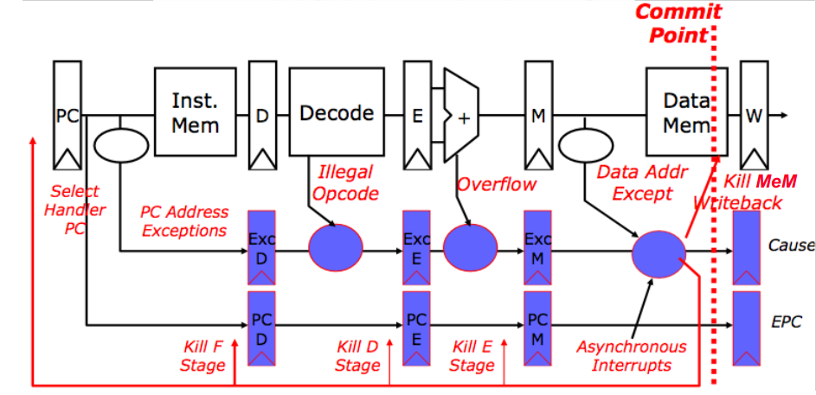
Precise Exceptions in MIPS Pipeline

Slide 7
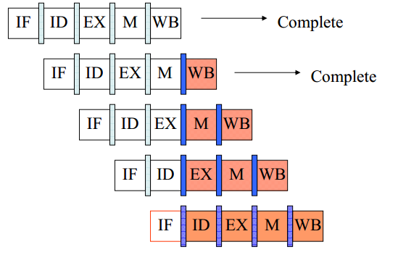
Precise Exceptions in MIPS Pipeline
To implement precise interrupt, the processor needs to flush IF、ID 、EXE 、MEM stages.
0x00 | add $1,$2,$3
0x04 | add $4,$5,$6
0x08 | add $7,$8,$9
0x0c | add $10,$11,$12
0x10 | add $13,$14,$15

Slide 8
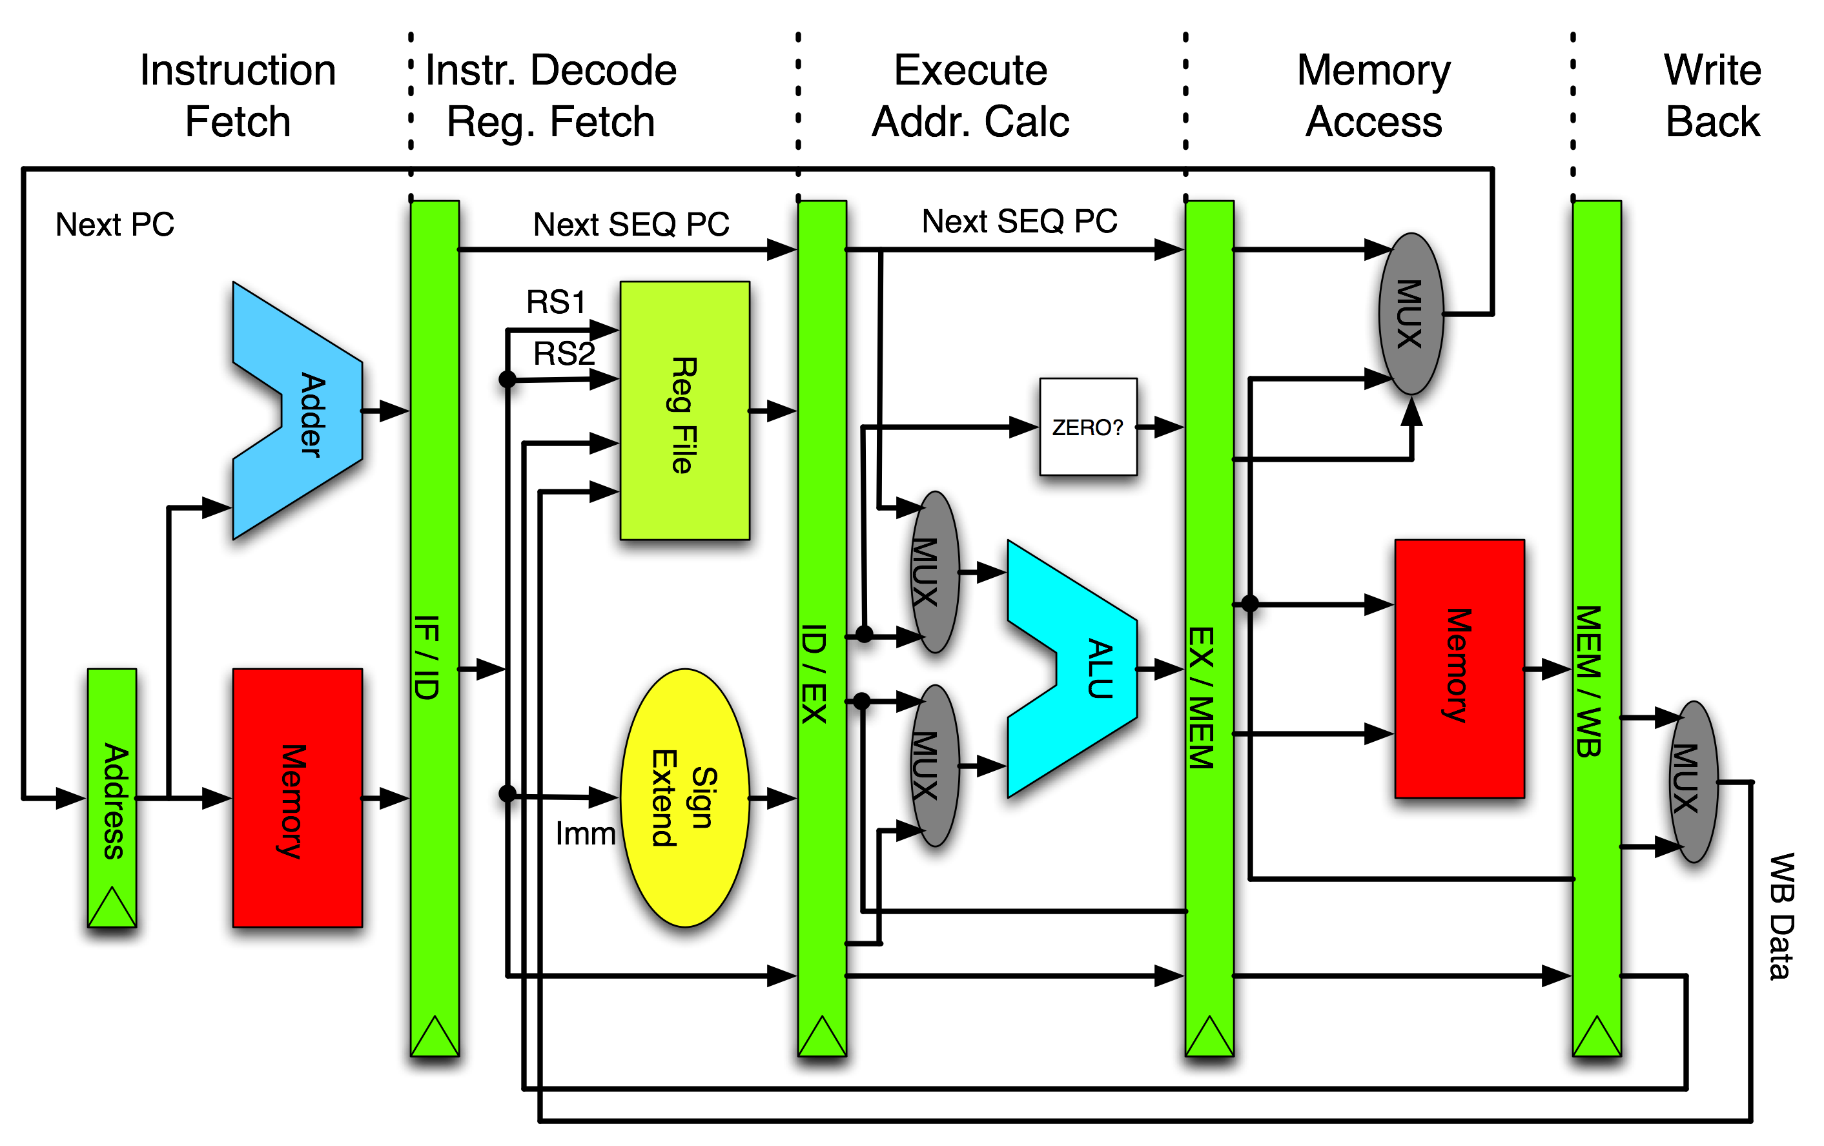
Flush register between stage and stage

Slide 9
About Precise Exceptions
An interrupt or exception is called precise if the saved processor state corresponds with the sequential model of program execution
Precise interrupt means that all instructions before the interrupt or faulting instruction are committed and those after it can be restarted from scratch.
If an interrupt occurred, all instructions that are in program order before the interrupt signaling instruction are committed, and all later instructions are removed (flush).

Slide 10
To implement a precise interrupt
Undo all instructions after the interrupting instruction
Restart from the faulting instruction.
Otherwise, the interrupt becomes imprecise.

Slide 11
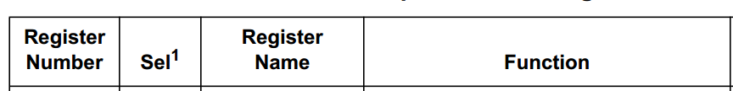
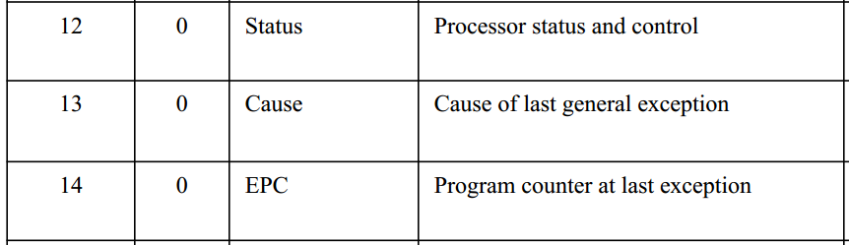
Review Coprocessors 0 registers
CP0 Registers
The processor is running in Kernel Mode or Debug Mode.

Slide 12
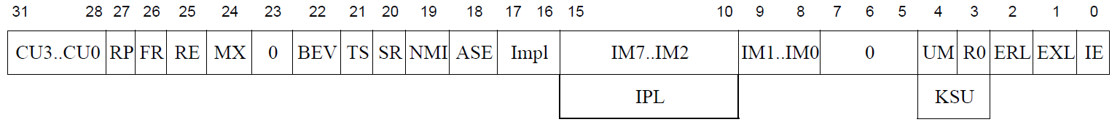
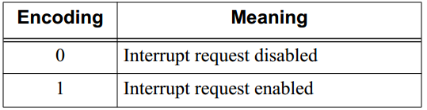
CP0 Registers - cpr12 (Status)
Status:
IM7…IM2 [15:10]:
Interrupt Mask: Control the enabling of each of the hardware interrupts.
IE [0]:
Interrupt Enable: Act as the master enable for software and hardware interrupts.

Slide 13
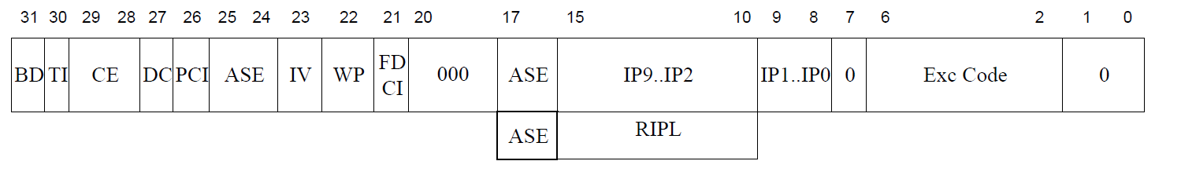
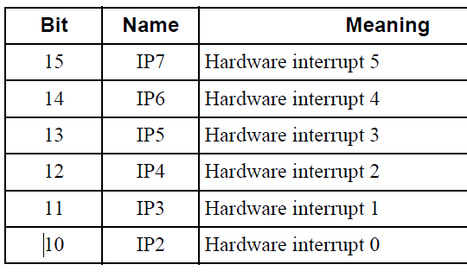
CP0 Registers - cpr13 (Cause)
Cause :
IP7…IP2 [15:10]:
record the reason for the exception in the Cause register.

Slide 14
MIPS Interrupt Processing
If interrupt is enabled and is not masked,
then, MIPS does interrupt processing in 5 steps.
Step 1. save current PC
Step 2. set state giving the cause of exception
Step 3. change to kernel mode
Step 4. disable further interrupts
Step 5. jump to exception handler address
(The red part will be the work to be implemented by this LAB)

Slide 15

MIPS Interrupt Processing
First, check interrupt mask field (CP0_status[15:10]) and interrupt enable field (CP0_status[0])
We need a way to tell the external device that the processor will serve its interrupt. We'll solve this problem by adding the pin, called IACK (interrupt acknowledge), that will be an output.
Clk
Irq
Iack

Slide 16
Step 1. save current PC
CP0_epc <= ? (which PC to save for pipeline CPU?)
When an interrupt is caused by external devices or by those interrupt causing instructions, we need to give a return address to the user program.
We can’t just save CP0_epc like this CP0_epc = current PC which is being used for fetching instruction.
Since the interrupt module is located at the WB stage, so the PC to be saved is (current PC) – 3 x 4.

Slide 17
Step 2. set state giving cause of exception
CP0_cause[15:10] <= (cause code for event)
We need to record the reason for the exception in the Cause register.

Slide 18
Step 4. disable further interrupts
We require a way to disable interrupts and exceptions. This is necessary to prevent exceptions and interrupts during this moment.
bit 0 of the Status register the field is called IE (Interrupt Enable)
Enabled = 1 Disabled = 0

Slide 19
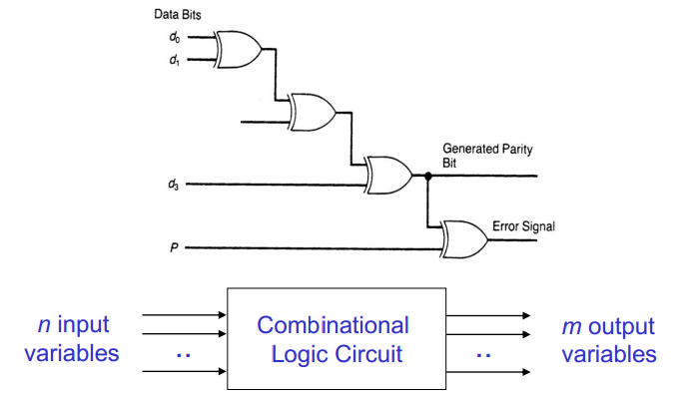
Combinational Circuit
A combinational circuit consists of logic gates whose outputs at any time are determined directly from the present combination of inputs without regard to the previous inputs.

Slide 20
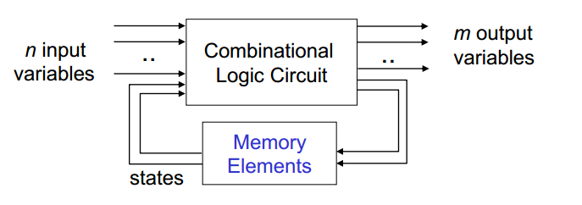
Sequential Circuit
A sequential circuit is a system whose outputs at any time are determined from the present combination of inputs and the previous inputs or outputs.

Slide 21
LAB 5: MIPS CPU Interrupt Unit

Slide 22
Tool used
實驗環境:
Modelsim (Run CPU simulator)
看wave來驗證我們的實作是否正確

Slide 23
實作
請同學以RTL code完成這顆MIPS CPU中interrupt_controller.v 空白部分,並且使用ModelSim編譯完成,最後放進上次 Lab 4 所撰寫的ISR,讓CPU能夠同時驗證軟體與硬體部分
請同學依照流程以及規定撰寫,請先複習前面投影片

Slide 24
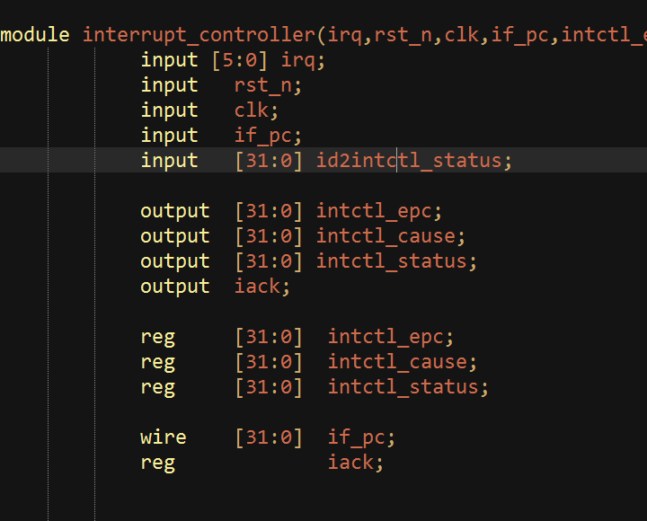
Finish the following code
請同學先了解會用到哪些input/output,再開始撰寫程式碼

Slide 25
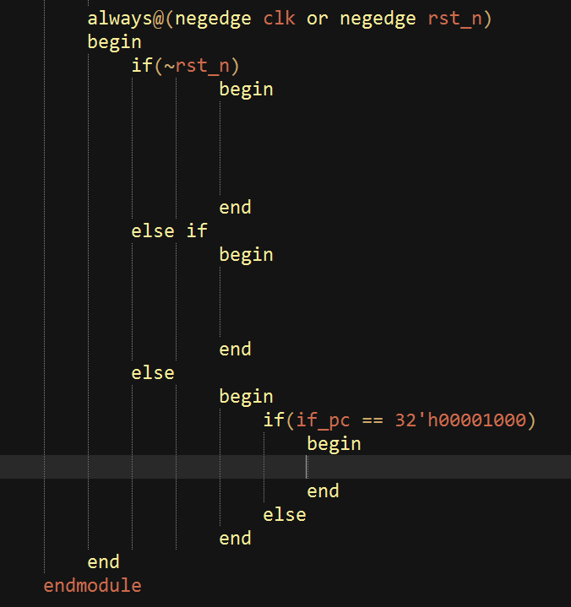
Finish the following code
請參考下一頁說明及code的註解,並依項目完成相對程式碼
1
2
3

Slide 26
Interrupt controller實作補充說明
rst_n表示為reset訊號且為負觸緣,此處必須完成當reset成立時候對interrupt control硬體初始化
先檢查IRQ是否被mask住,同時檢查是否enable interrupt ,之後流程如有不懂請自行閱讀前面投影片
此部分是當pc值表示0x00001000表示已進入ISR,否則表示上述皆不成立的情況

Slide 27
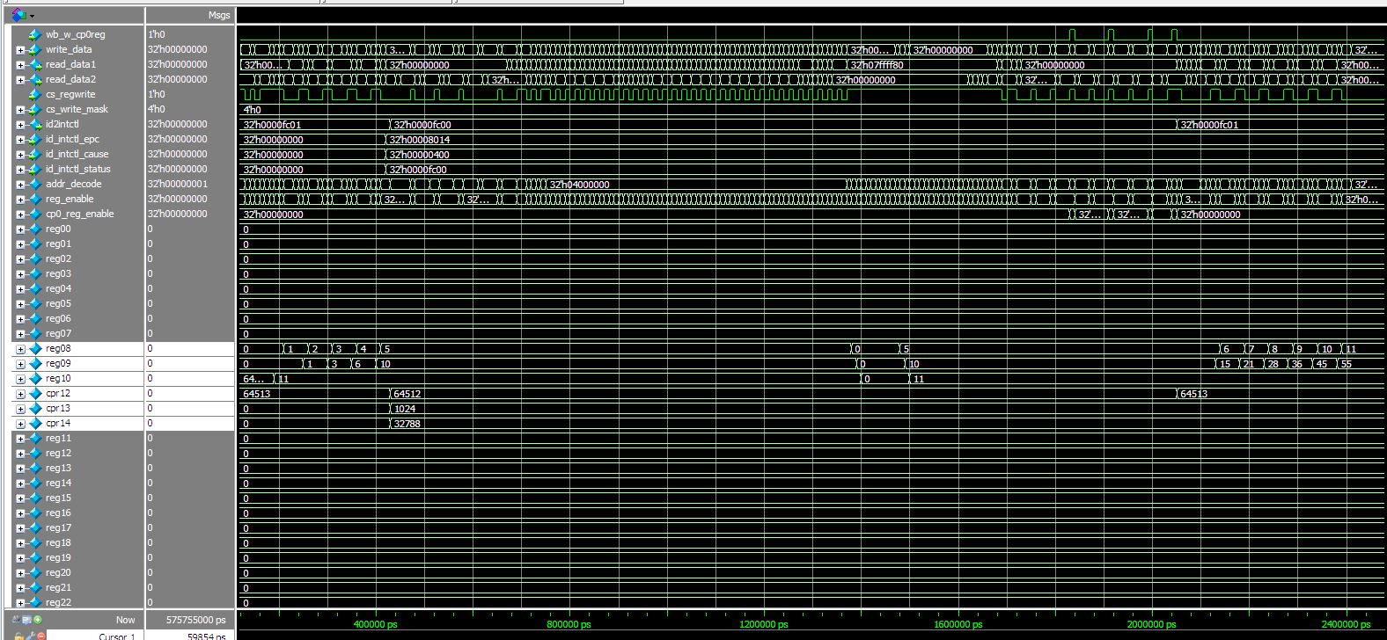
Waveform

Slide 28
實驗結報
結報格式(每組一份)
封面
實驗內容(程式碼註解、結果截圖)
實驗心得
繳交位置
ftp : 140.116.164.252
帳號/密碼 : computer_arch_lab / co2014
DeadLine:下次上課前
TA Contact Information:
助教信箱 : q36034099@mail.ncku.edu.tw
Rm 92617
Office hour : (Mon)1000~1200
28

